Slide 1

Emotion Recognition of Speech using Deep Learning
by
P.Dilwar
Roll No. 194G5A0502
B.Pushpalatha
Roll No. 184G1A0560
G.Lakshmi Manasa
Roll No. 184G1A0533
T.Madhavi
Roll No. 184G1A0538
Under the guidance of
Dr. T .Venkata Naga Jayudu _{M.Tech.,Ph.D}
Associate Professor
Department of Computer Science and Engineering
Srinivasa Ramanujan Institute of Technology
(Affiliated to JNTUA & Approved by AICTE) (Accredited by NAAC with ‘A’ Grade & Accredited by NBA (EEE, ECE & CSE)
Rotarypuram Village, B K Samudram Mandal, Ananthapuramu – 515701.
2021 - 2022

Slide 2
Abstract
Emotion Recognition of Speech is the act of attempting to recognize human emotion and affective states from speech. This is capitalizing on the fact that voice often reflects underlying emotion through tone and pitch. This is also the phenomenon that animals like dogs and horses employ to be able to understand human emotion.
Existing system of Emotion Recognition Of Speech was developed with Multilayer Perceptron(MLP).Generally MLP is best, when the model is quality trained. this is not always possible in real world scenario. The proposed system of Emotion Recognition Of Speech will be developed with Ensemble Methods that is Convolutional Neural Network(CNN)

Slide 3
Contents
Introduction
Literature Survey
Existing System
Proposed System
Problem Definition
Requirements
Architecture
UML Diagrams
Data flow Diagram
Implementation
Screenshots
Conclusion
References

Slide 4
Introduction
Speech recognition is the process of converting an acoustic signal, captured by microphone or a telephone, to a set of characters.
Detecting emotions is one of the most important marketing strategies in today’s world. You could personalize different things for an individual specifically to suit their interest.
recognition system is generally composed of three parts, the first being speech signal acquisition, then comes the feature extraction followed by emotion recognition.
Some examples could be including call centres to play music when one is angry on the call. Another could be a smart car slowing down when one is angry or fearful. As a result, this type of application has much potential in the world that would benefit companies and even safety to consumers.

Slide 5
Literature Survey
[Muzaffar Khan Tirupati Goskula, Mohammed Nasiruddin, Ruhina Qyazi]”Comparison between K-nn and svm method for speech emotion recognition”,(IJCSE),2011.[1]
Existing system:
SVM
Proposed system:
KNN

Slide 6
Contd..
[Xianxin Ke,Yujiao Zhu,Lei Wen and Wenzhen Zhang]”Speech Emotion Based on SVM and ANN”,International Journal of Machine learning and Computing,Vol.8,No.3,June 2018.[2]
Existing system:
ANN
Proposed system:
SVM

Slide 7
Contd…
[Sanjita. B. R, Nipunika. A, Rohita Desai] “Speech emotion recognition ”,” Department of ECM Sreenidhi Institute of Technology and Science, Telangana, India, 2020.[3]
Existing system:
SVM
Proposed system:
MLP

Slide 8
Existing System
The Existing Speech Emotion Recognition uses the Multilayer Perceptron Classifier(MLP).
RAVDESS is the dataset used in the system has speeches of 24 people with variations in parameters.This dataset is passed to MLP classifier to train the model.
Multilayer Perceptron classifier relies on an underlying Neural networks to perform classification.MLP classifier implements a MLP algorithm and trains the neural network.
The Classifier identifies different categories in the datasets and classifies them into different emotions. The model will now be able to understand the ranges of values of the speech parameters that fall into specific emotions.
The features such as MFCC,Contrast,Mel,chroma and Tonnetz etc.,extracted from the fed audio will be send to model.Using this features independently and passing it altogether we get a emotion prediction.
Generally MLP is best,when the model is quality trained.This is not always possible in real world.
There are some limitation in MLP too.

Slide 9
Proposed System
The proposed system of Emotion Recognition Of Speech will be developed using Convolutional Neural Network(CNN) which is much better than MLP.
Emotions are subjective, people would interpret it differently. It is hard to define the notion of emotions.
Annotating an audio recording is challenging. Should we label a single word, sentence or a whole conversation? How many emotions should we define to recognize?
It can detect important features without human supervision, computationally efficient, easy to integrate and yields high performance.

Slide 10
Problem Definition
Emotion Recognition Of Speech is becoming increasingly important in various applications. At present, Emotion Recognition Of Speech is an emerging crossing field of artificial intelligence and artificial psychology; besides it is a popular research topic of signal processing and pattern recognition. So, accuracy is most important when speaking about Emotion Recognition Of Speech. Our project aims at increasing the accuracy of recognizing emotion through speech.

Slide 11
Requirements
Hardware Requirements :
Processor : i3/Intel Processor
RAM : 8GB
Hard Disk : 128GB
Software Requirements :
Operating System : Windows 10
Language : Python 3.8
Platform : Google Collab, Jupyter Notebook
Libraries : Numpy, Pandas, Matplotlib, Seaborn, Sk Learn

Slide 12
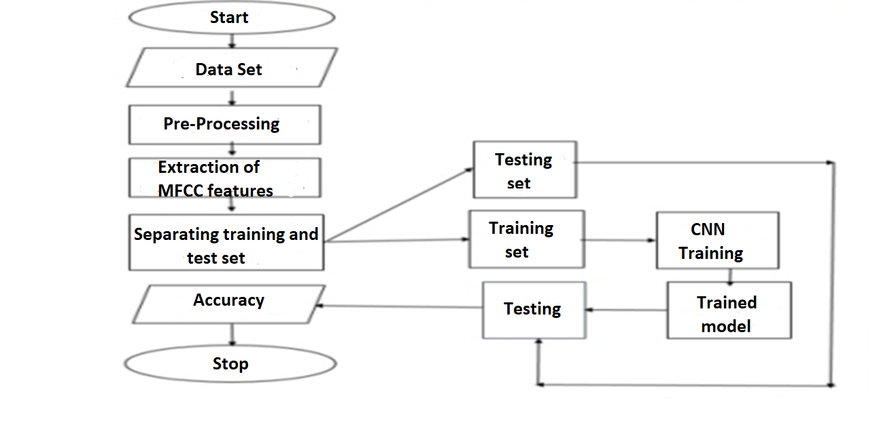
Data Flow Diagram

Slide 13
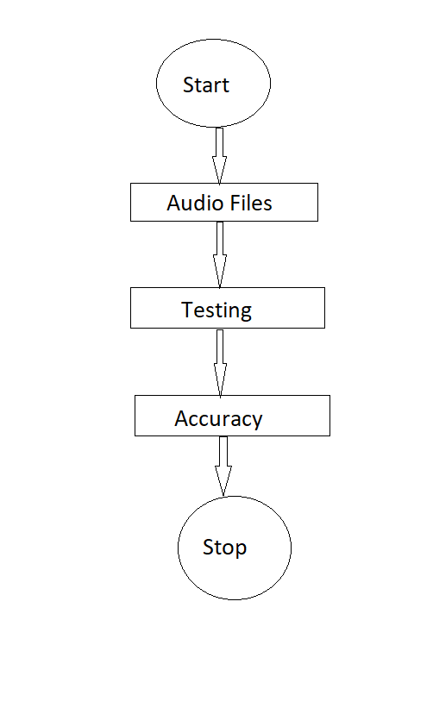
Contd…

Slide 14
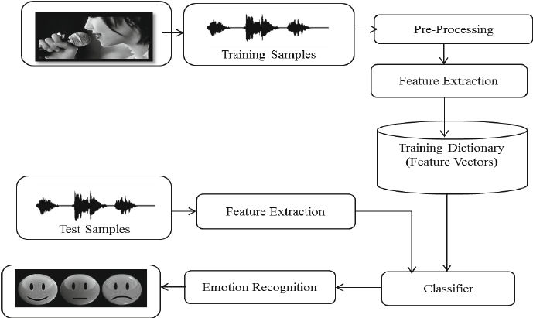
Architecture
Recording Data
Emotions

Slide 15
Implementation
Gathering DataSet:
In this RAVDESS dataset is used, this is the Ryerson Audio-visual Database of Emotional Speech and song dataset , and is free to download.
This dataset contains 7,356 files (total size;2.48GB).This database contains 24 professional actors voices.
Emotions in this dataset are
Neutral
Happy
Sad
Angry
Fearful
Disgust
surprise

Slide 16
Contd..
Data Preprocessing:
Sample code:
import pandas as pd
import os
import librosa
import glob
import numpy as np
lst = np.array([])
labels = []
i=0
shapes = []
bookmark=0
files=[]
s_arr = np.zeros((1440,13,216))

Slide 17
Contd..
Sample code for loading Dataset:
for file in glob.glob("/content/gdrive/My Drive/SER/Actor_*/*.wav"):
X,sample_rate=librosa.load(file,res_type=‘Kaiser_fast’,duration=2.5,sr=22050*2,offset=0.5)
sample_rate = np.array(sample_rate)
mfccs = librosa.feature.mfcc(y=X, sr=sample_rate, n_mfcc=13)
files.append(file)
result = np.zeros((13,216))
result[:mfccs.shape[0],:mfccs.shape[1]] = mfccs
s_arr[i] = result
Splitting Dataset:
from sklearn.model_selection import train_test_split
ravdess_train_X, ravdess_valid_X, ravdess_train_y, ravdess_valid_y = train_test_split(ravdess_X,ravdess_y,test_size=0.2,random_state=42)

Slide 18
Contd…
CNN Model Creation:
import keras
import numpy as np
import matplotlib.pyplot as plt
import tensorflow as tf
from keras.preprocessing import sequence
from keras.models import Sequential
from keras.layers import Dense, Embedding
from tensorflow.keras.utils import to_categorical
from keras.layers import Input, Flatten, Dropout, Activation, BatchNormalization
from keras.layers import Conv2D, MaxPooling2D, LSTM, Lambda
from keras.models import Model
from keras.callbacks import ModelCheckpoint
from sklearn.model_selection import train_test_split
from keras import backend as K
from tensorflow.keras.utils import plot_model

Slide 19
Contd..
model_ravdess = Sequential()
kernel = 5
model_ravdess.add(Conv2D(32, 5,strides=2,padding='same',
input_shape=(13,216,1)))
model_ravdess.add(Activation('relu')
model_ravdess.add(BatchNormalization())
# model_ravdess.add(MaxPooling1D(pool_size=(8)))
model_ravdess.add(Conv2D(64, 5,strides=2,padding='same',))
model_ravdess.add(Activation('relu'))
model_ravdess.add(BatchNormalization())
model_ravdess.add(Activation('relu'))
model_ravdess.add(BatchNormalization())
# model_ravdess.add(MaxPooling2D(pool_size=(2,3)))
# model_ravdess.add(Lambda(lambda x: K.squeeze(x, axis= 1)))
model_ravdess.add(Flatten())

Slide 20
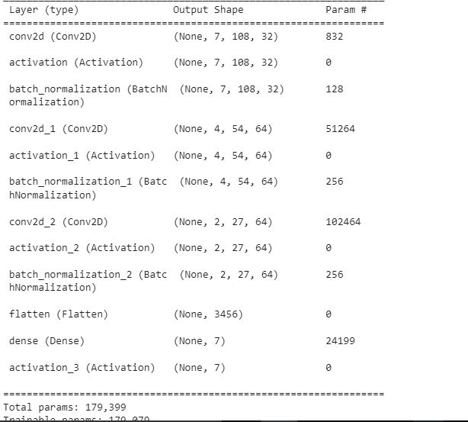
Contd..
Output Screenshot:

Slide 21
Contd..
Predicting Accuracy
model_ravdess.compile(loss='sparse_categorical_crossentropy',
optimizer=opt,
metrics=['accuracy'])
model_ravdess.evaluate(ravdess_valid_X,ravdess_valid_y)
Accuracy Output:

Slide 22
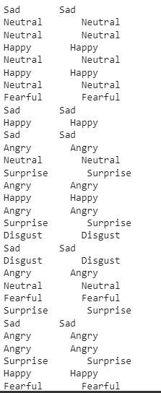
Contd..
Actual values and Predicted Values:
The following code will display the actual values and predicted values .
classes = ['Neutral','Happy','Sad','Angry','Fearful','Disgust','Surprise']
for i in range(len(classes_x)):
print(classes[classes_x[i]], ' ',classes[ravdess_valid_y[i]])

Slide 23
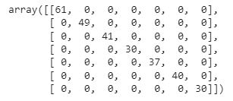
Contd..
Confusion Matrix Representation:
from sklearn.metrics import confusion_matrix
d=confusion_matrix(classes_x, ravdess_valid_y)
d

Slide 24
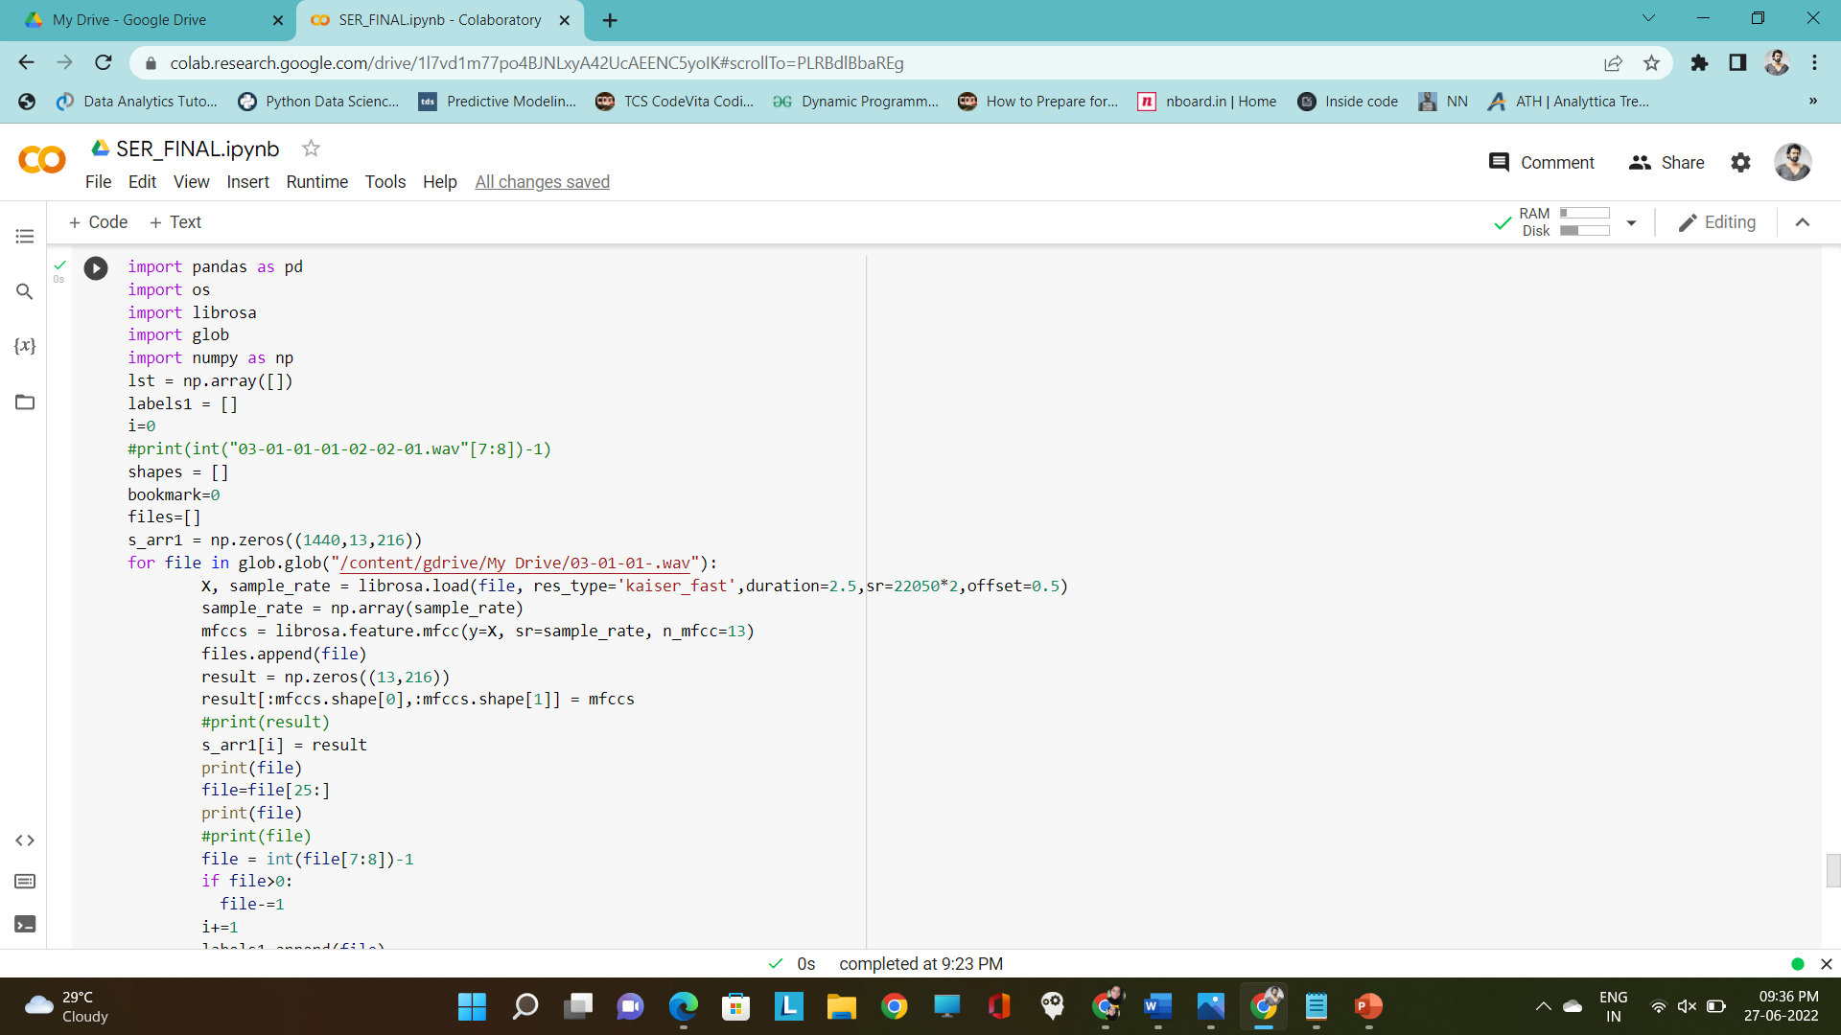
Screenshots
Test case 1:

Slide 25
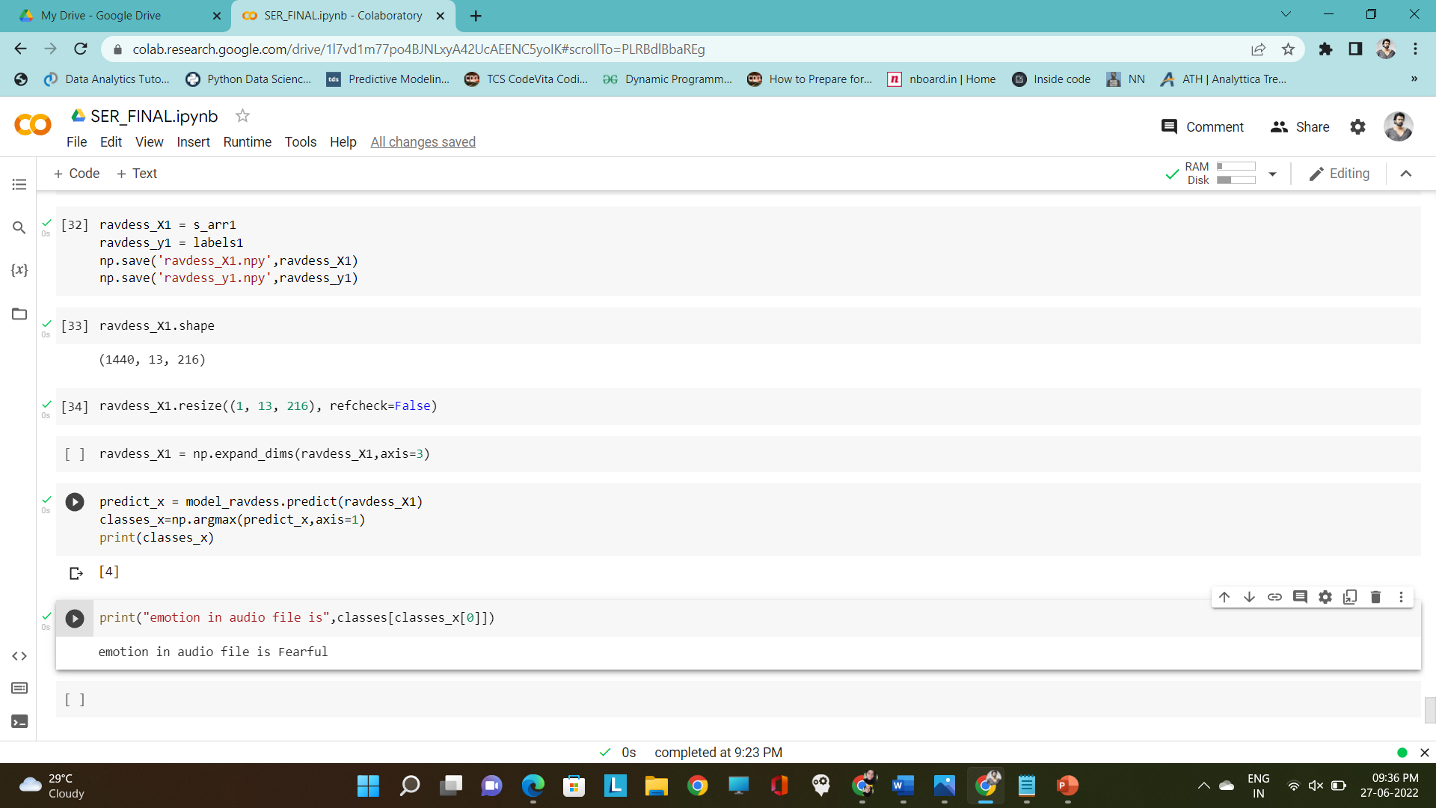
Contd…
Output : Fearful

Slide 26
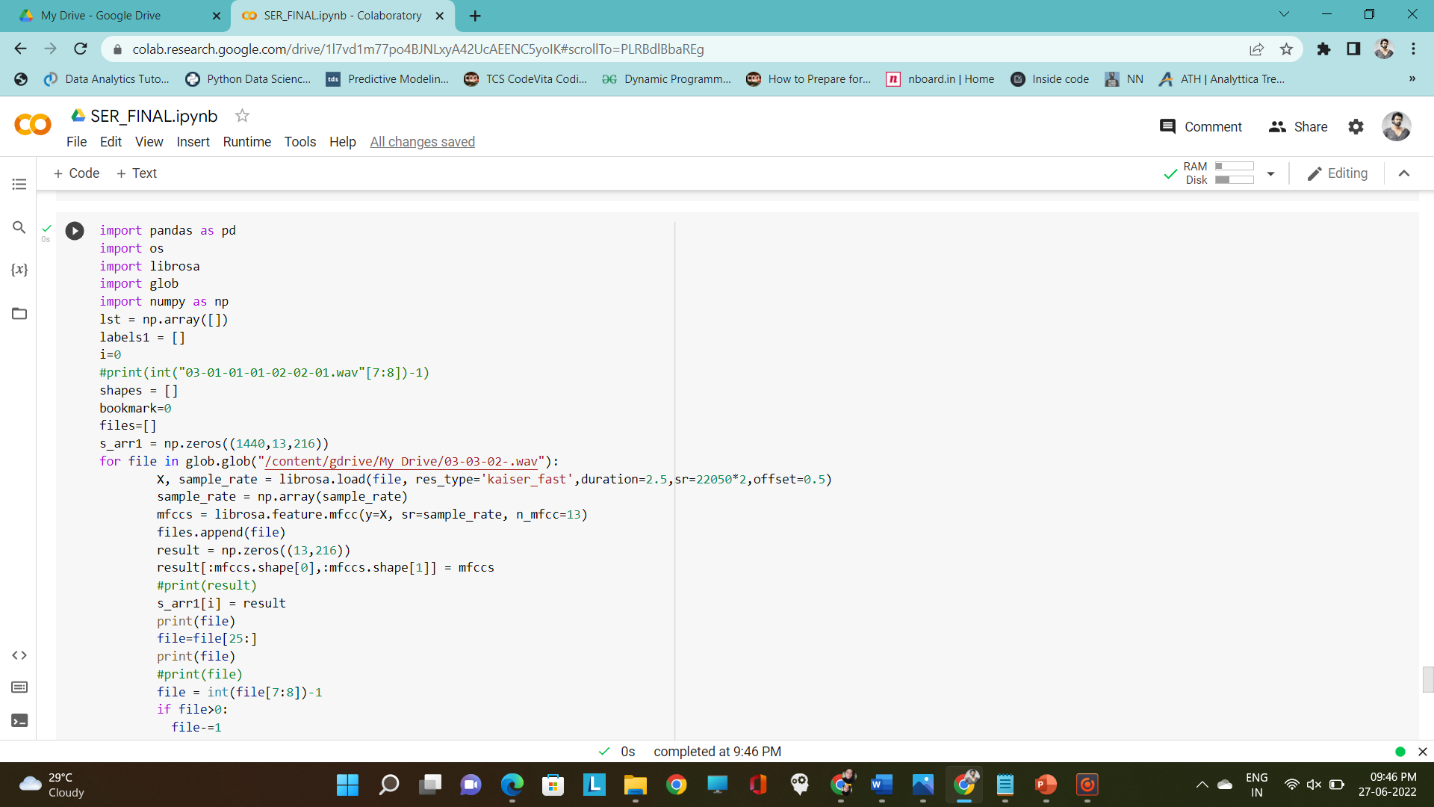
Contd…
Test case 2:

Slide 27
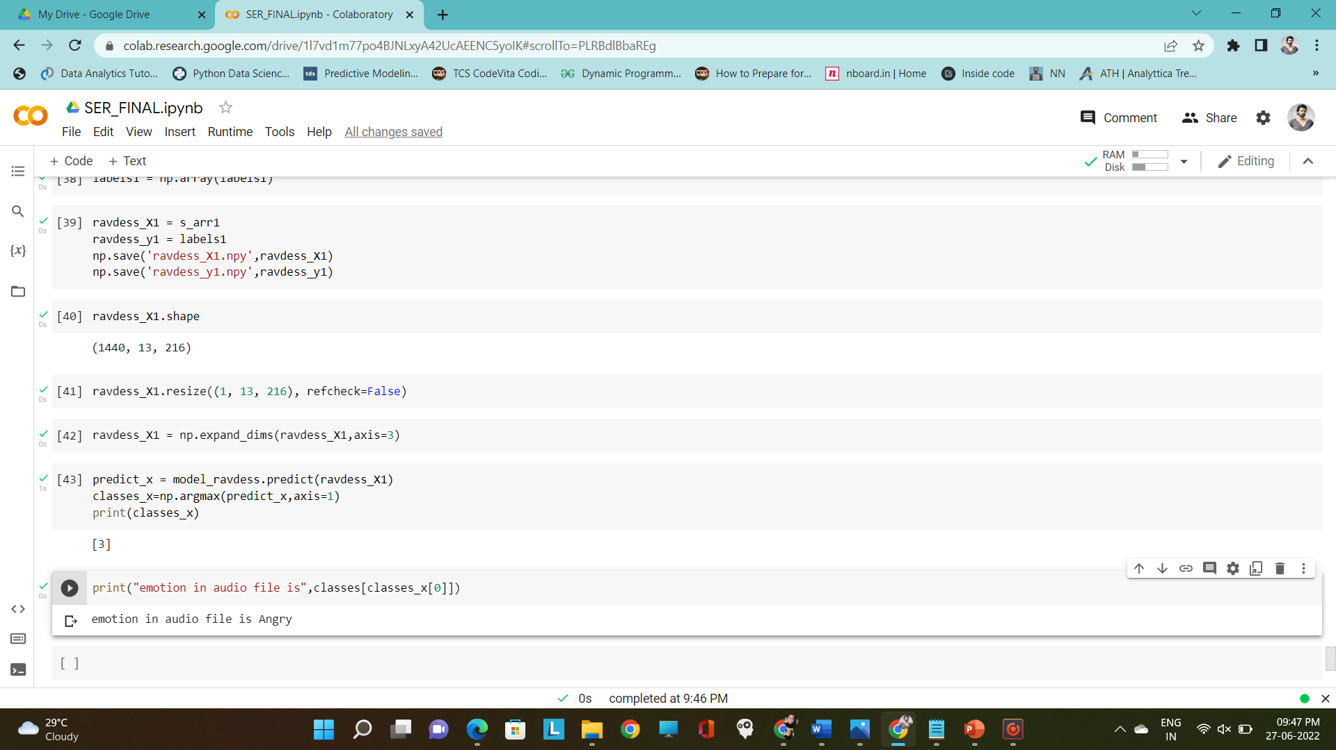
Contd…
Output : Angry

Slide 28
Conclusion
The results for various emotions are captured and tested to achieve more accuracy around 95%.we have performed this experiment based on proposed system.
In this experiment we are using Convolutional neural networks(CNN) were trained over the RAVDESS dataset, and the performance is evaluated.
The results are dependent on what emotions the user gives to the system and the system accepts in the form of voice then processed and then predicts by using CNN algorithm, MLP, Contract this features extraction is used to extract emotional characteristics from the emotion speech signal. Our proposed model achieves nearly 95% accuracy using CNN.
The data was split into the ratio 80-20 and increasing the accuracy and also the efficiency of the classification of the process.

Slide 29
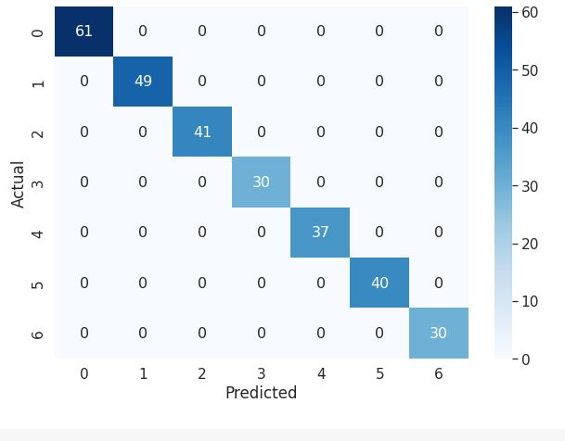
Contd..
Accuracy:
Confusion Matrix:

Slide 30
References
[1].Muzaffar Khan ,Tirupathi Goskula,mohmmed Nasiruddin,Ruhina Qyazi,”Comparison between K-nn and svm method for speech emotion recognition”,(IJCSE),2011.
[2].Xianxin Ke,Yujiao Zhu,Lei Wen and Wenzhen Zhang,”Speech Emotion Based on SVM and ANN”,International Journal of Machine learning and Computing,Vol.8,No.3,June 2018.
[3]. DataFlair Team, “Speech emotion recognition using librosa”, 2019
[4]. Sanjita. B. R, Nipunika. A, Rohita Desai, “Speech emotion recognitin ”,” Department of ECM Sreenidhi Institute of Technology and Science, Telangana, India, 2020.

Slide 31
Thank You!!!

